Slide 1
Reproducing Speech Models Using Feature-Labelled Audio GANs
By – Utkarsh Bhardwaj

Slide 2
Inception of Concept
The main objective by definition is to reproduce prepared speech models by usage of Generative Adverserial Network structure methodology.
In the proposed adversarial nets framework, the generative model is pitted against an adversary: a discriminative model that learns to determine whether a sample is from the model distribution or the data distribution. Competition in this game drives both teams to improve their methods until the counterfeits are indistiguishable from the genuine article [1].
In this case, generative model generates samples by passing random noise through a multilayer perceptron, and the discriminative model is also a multilayer perceptron. Both models are trained using only the highly successful backpropagation and dropout algorithms [2] and sample from the generative model using only forward propagation.

Slide 3


Slide 4
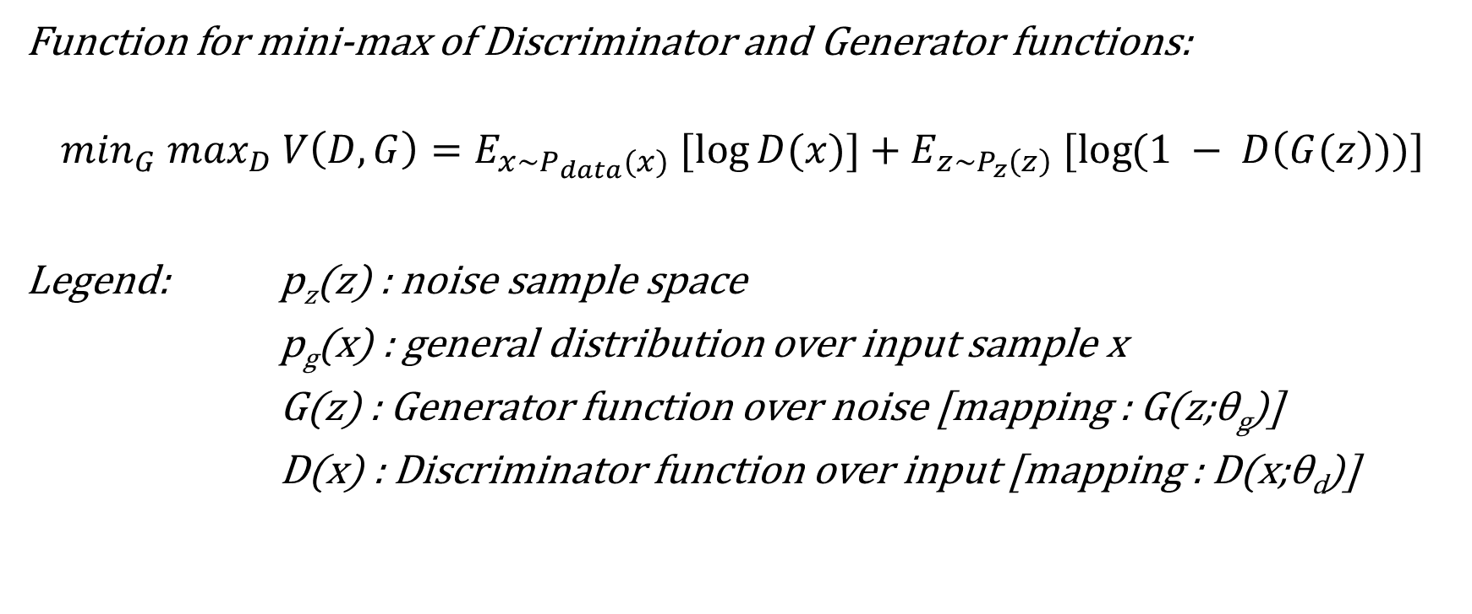
Mini-max Iterative Function
Function for mini-max of Discriminator and Generator functions:
$$\min_{G} \max_{D} V\left(D,G\right)=E_{x\sim P_{data}(x)} [\log{D(x)]}+E_{z\sim P_{z}\left(z\right)} [\log{(1 − D\left(G(z\right)))]}$$
Legend: p_{z}(z) : noise sample space
p_{g}(x) : general distribution over input sample x
G(z) : Generator function over noise [mapping : G(z;θ_{g})]
D(x) : Discriminator function over input [mapping : D(x;θ_{d})]

Slide 5
Project Heirarchy and Process Flow
Obtain TFRecord dataset for speech (sc09 taken in this case).*
Convert it to tensor feedable value (in this case spectrogram methodology applied).
Pass to the GAN Discriminator’s input as feed and define random Gaussian noise for Generator model.
Begin the training over random seed sample set from the input space.
The models pass them through downscaling and upscaling convolutions respectively.
Backup checkpoints and generate preview audio samples for every 60 minutes of training.
For each preview audio sample, convert it to temporary spectrogram for error comparison.
After training to a certain inception point, crop out 1 second clips from random given number of previews (in order of their creation) and concatenate them under summary clip. The summary clips are presented in this presentation to show evolution of network over time.
Reset the hyper parameter and start training over another set of input feed.
*This implementation is tensorflow library oriented and thus requires usage of dataset in TFRecord format.

Slide 6
Experiments and Inferences
3 experiments were conducted with differing labels and speech accents.
Correct sc09 labels, English UK accent
Correct sc09 labels, English merged accents (Scottish male, UK female, Welsh male, Australian female, etc.)
Incorrect sc09 labels, English UK accent [test for label error handling##]
Observations on models trained for each sample space, are provided further in table in a concise manner.
## Accounted for here

Slide 7

Correct label UK Accent | Correct label Merged Accent | Incorrect Label
The spectrogram analysis reveals that the generated previews had almost similar, if not the same spectrogram images Error rate: 14% approximate | The spectrogram analysis had significant bump in errors, mostly due to overlapping sample space. Error rate: 23% approximate | The resultant spectrogram were distinctive and variant from the input space. Error rate: 73% approximate
The preview samples showed incomprehensible data with random peaks of noise. Result: noise during expected speech | The preview samples consisted of random noise peaks. Result: random noise | Preview data consisted of silent periods with inaudible noise. Result: random noise, heavy loss
Verdict:
Spectrograms : Barely acceptable results
Semantics : Unacceptable results

Slide 8
Concept Reform: A Different Approach
The prime cause of the incomprehensible data is presumed to be the difference in perception of visual image data and the audio input.
Audio has time as prime feature unlike that of image that follow contrast, intensity and edges. Also both media differ in the approach of semantics: Image changes with both dimensions of length and breadth while audio is a periodic function of time

Slide 9
Proposed Solution
First instinct pushes to convert the audio file to audio features, but, that wouldn’t suite the architecture of GANs and thus cannot be expanded upon by noise input.
Thus, the implementation of a modified GAN comes into picture, named WaveGAN [3].
This algorithm proposes to feed the audio in one dimensional convolution instead of a regular image’s 2-dimensional counterpart.

Slide 10
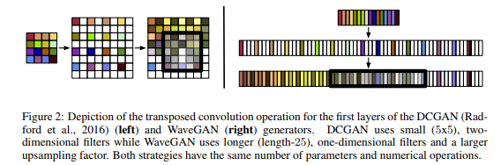
An excerpt from WaveGAN paper [3]

Slide 11
Changes in Traditional DCGAN Flow
Flatten the 2-D convolutions (5x5 in this case) to 1-D convolutions (25 convolutions)
Multiply stride-factor with the same factor to account for flattening and maintain same dimensionality as the DCGAN
Switching to WGAN-GP*# algorithm [4][5]
*WGAN : Necessary to account for non-linear convergence of generator function
#Results shown without WGAN-GP switch in “Other Observations” page

Slide 12
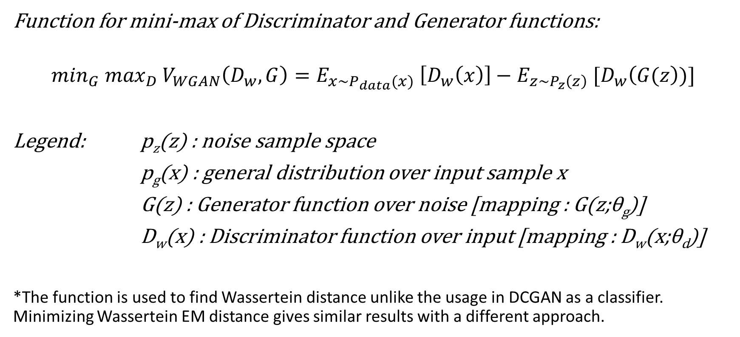
Modified Function for WaveGAN (WGAN-GP)
Function for mini-max of Discriminator and Generator functions:
$$\min_{G} \max_{D} V_{WGAN}\left(D_{w},G\right)=E_{x\sim P_{data}(x)} \left[D_{w}\left(x\right)\right]−E_{z\sim P_{z}\left(z\right)} [D_{w}\left(G(z\right))]$$
Legend: p_{z}(z) : noise sample space
p_{g}(x) : general distribution over input sample x
G(z) : Generator function over noise [mapping : G(z;θ_{g})]
D_{w}(x) : Discriminator function over input [mapping : D_{w}(x;θ_{d})]
*The function is used to find Wassertein distance unlike the usage in DCGAN as a classifier. Minimizing Wassertein EM distance gives similar results with a different approach.

Slide 13
Correct label UK Accent | Correct label Merged Accent | Incorrect Label
The spectrograms were a bit dissimilar but possess the similar waveform Error rate: 34% approximate | The spectrograms were very different from feed but still possessed similar waveform characteristics Error rate: 12% approximate | Resultant spectrograms were mostly new and varied vastly from feed Error rate: 64% approximate
The preview samples were very clear and very much acceptable, although it contained overlapping qualities of different feed Result: Acceptable, comprehensible | The preview samples were very clear and comprehensible. Result: Acceptable, comprehensible | Preview samples were acceptable yet were very incomprehensible. Result: Partly acceptable*
*A workaround is proposed in Proposed Modifications

Slide 14
Verdict
Although spectrograms showed vastly different characteristics, it can be shadowed by the fact that spectrogram comparison is not an accurate comparison for speech semantics and quality comparison. Although, it would be considered if the objective would have been to clone the feed, unlike this case, where main objective is to create another model altogether.
The model passed semantics comparison with high comprehension.
Thus, this algorithmic model is proposed to pass with minor losses.

Slide 15
Proposed Modifications for Incorrect Labels
Due to semantic mismatch in this case of incorrect labels, it is proposed to look into the current model and provide a condition based separation and concatenation of labels. In this case, labels re treated as separate tensors when performing convolutions.[6].

Slide 16
Some other observations
Without WGAN-GP switch (heavy noise)
Phase filter over collapsed model
Custom noise
Evaluation using the custom noise
Failed attempt (after 1000 iterations)

Slide 17
Future Considerations and Expansions over Current Model
WaveGAN algorithm approach opens a new plethora of possibilities to be experimented with.
Some of them include:
Conditional WaveGAN: Conditioning of raw audio to improve baseline ASR system
SEGAN: Speech enhancement GAN
MuseGAN: Multi-track sequential generative adversarial networks for symbolic music generation and accompaniment
GANTTS and VCGAN: GAN application over text-to-speech and voice conversion domain.

Slide 18
References
[1] Ian J. Goodfellow, Jean Pouget-Abadie , Mehdi Mirza, Bing Xu, David Warde-Farley, Sherjil Ozair , Aaron Courville and Yoshua Bengio. Generative Adversarial Nets, arXiv:1406.2661
[2] Hinton, G. E., Srivastava, N., Krizhevsky, A., Sutskever, I., and Salakhutdinov, R. (2012b). Improving neural networks by preventing co-adaptation of feature detectors. Technical report, arXiv:1207.0580.
[3] Chris Donahue, Julian McAuley, Miller Puckette. Adversarial Audio Synthesis using Generative Adversarial Networks, arXiv:1802.04208
[4] Martin Arjovsky, Soumith Chintala, and Leon Bottou. Wasserstein GAN. In ´ ICML, 2017.
[5] Ishaan Gulrajani, Faruk Ahmed, Martin Arjovsky, Vincent Dumoulin, and Aaron Courville. Improved training of Wasserstein GANs. In NIPS, 2017.

